Slide 1

Product Overview Find a Yellow Ribbon Program Tool
Last Updated: November 2020

Slide 2
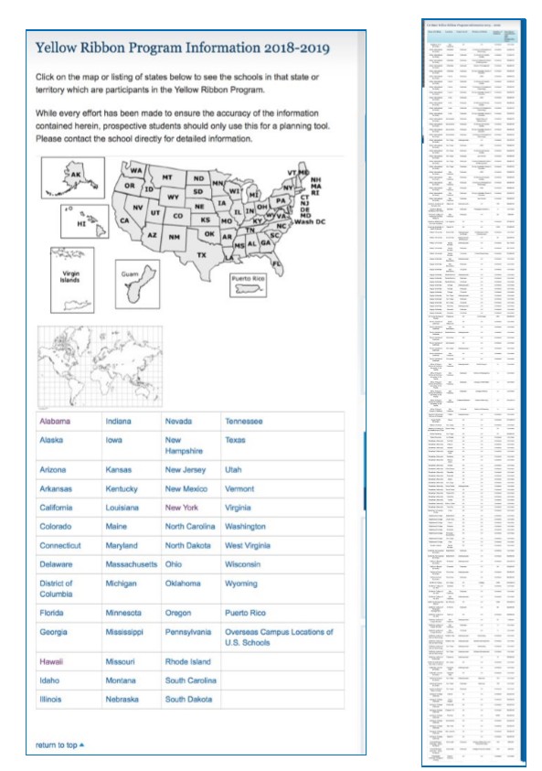
What is the Problem to be Solved?
Yellow Ribbon funding is a component of the Post 9/11 GI-Bill education benefit that awards Veterans additional funds toward their education.
The legacy VA online experience required users to navigate one page per state and manually search a static table to find benefit information. In addition, there was no ‘single source of truth’ for the Yellow Ribbon school data – the information was aggregated manually from various sources (emails, notes, etc.)
Our bet: Veteran students will use a searchable, filterable tool that allows them to search and browse school data relevant to the Yellow Ribbon program. Providing this will increase engagement in the Yellow Ribbon, Post-9/11 GI Bill programs.

Slide 3
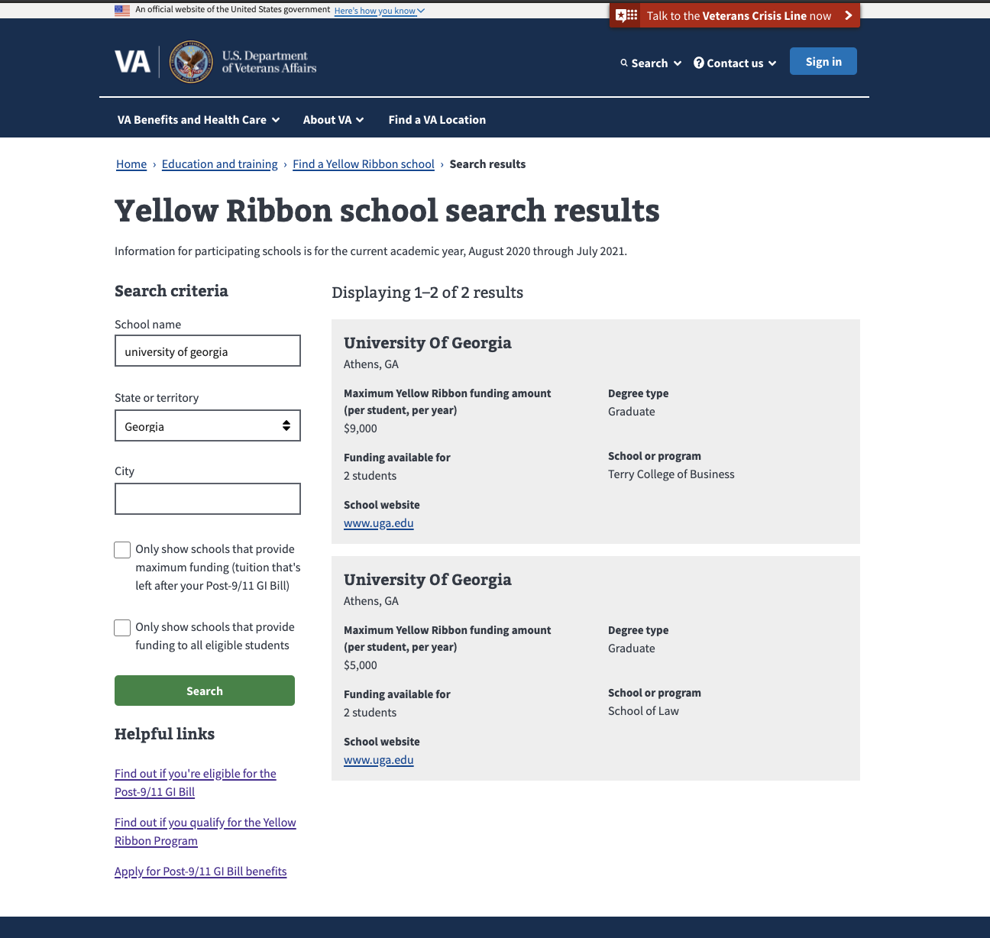
Solution: A modernized Find a Yellow Ribbon Program Tool
MVP Release 1.0 (March 2020)
New Find a Yellow Ribbon Program Tool
Modern VA.gov user-centered design (e.g. Mobile and a11y optimized)
Search/filtering: Ability to filter list by school name, location and program type
Schools that provide maximum funding
Schools that provide funding to all eligible students
Search results with key details
Maximum amount of funding
Funding available for number of students
Degree type
Participating school/program
School Website link
Analytics to track performance
Single source data feed for school information

Slide 4
Data Flow Diagram
The MVP product is a a single-page application that leverages an existing API (GI Data Service) and allows users to search for YR schools based on relevant criteria.
School data is updated annually via participating schools
That data is then collected by the VA YRP team, updating a Sharepoint spreadsheet.
The Sharepoint team then uploads the CSV to the GIDS data base, where the data is normalized.
This data is now available to the front end client via the vets-api endpoint.
Note:
What about previous year data?

Slide 5
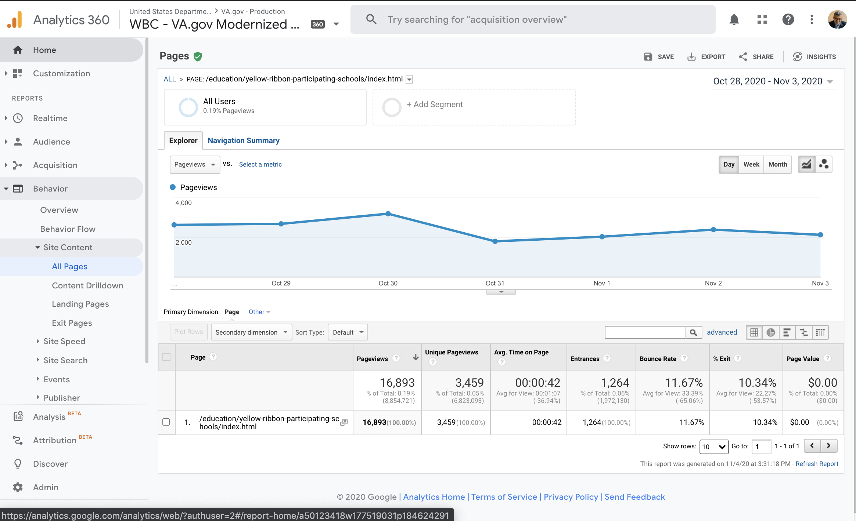
What We’ve Learned (so far)
Significant increase (over 30%) in views for the Yellow Ribbon school data, compared to the legacy experience
Over half of the views for the new tool result in a user exploring the Yellow Ribbon Program page, which offers information on the program and how to apply
Hello – sharing Yellow Ribbon school search tool data for the past 30 days: Oct 10 – Nov 8. Compared to the period Aug – September, this is 12% lower volume. There was a big spike in August – perhaps that is due to the time of the year when students are starting or planning for the new school year? Despite the pandemic, students still seem to be looking up YR participating schools.
8,892 unique searches (excludes traffic on VA network)
1,830 (of 8892) on mobile or tablet
Top 10 schools searched for (and search refinements):
nyu (refined search term: “new york university”)
columbia (refined search term: “columbia university”)
harvard ( à yale)
yale ( àharvard)
usc (à university of southern california)
stanford (àharvard)
harvard (à princeton)
harvard ( à stanford)
ucla (à university of california)
boston college (à boston university)

Slide 6
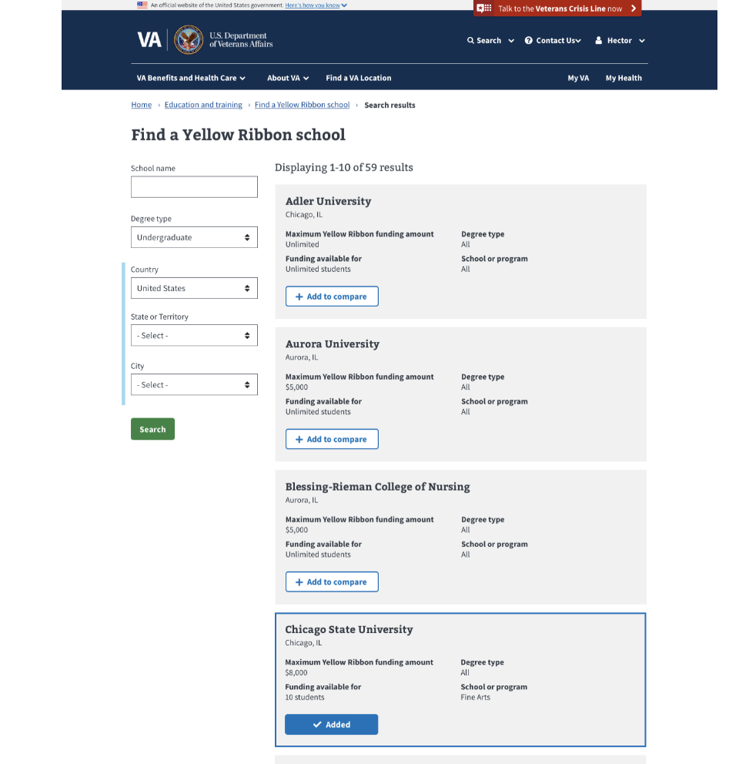
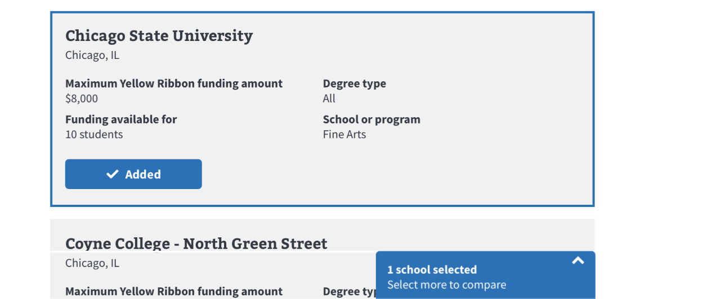
What Comes Next
Side-by-side comparison functionality (de-scoped from MVP) (https://vsateams.invisionapp.com/share/9SVV3Y8MBDP#/screens)
Ability to reduce the number of the initial search results via filtering (review search terms and filters used to better understand what Veteran students are searching for and how we could provide that to them sooner)
Add support for searching school names by common abbreviations, so that searching for abbreviated school names like ‘USC’ would return results for ‘University of Southern California’ (6,000 schools in program/DB)
Bring YR participating school information into the benefit hub as a more dynamic, user-friendly content (#8347)
Does YRP tool need to be more findable by veterans?
Address accessibility issues (#8791, #9374, #9723)
Legacy program info need to be posted (e.g., two years back)?
Assess the impact of Yellow Ribbon tool on Post-911 GI Bill Benefit usage
Do note: Veterans will be confused about the difference between this and the GI Bill Comparison Tool, and not understand the need for two separate tools
https://github.com/department-of-veterans-affairs/va.gov-team/issues?q=is%3Aissue+is%3Aopen+Yellow+Ribbon+label%3Avsa-public-websites+

Slide 7
What Comes Next
Automated search term type ahead suggestions – e.g., UCLA, UNC, NYU with type ahead suggestion
Stakeholder team is GIDS (GI Data Service) – Luke Tichner; Brian Grubbs is tech manager of DB, Joseph Welton/Janice Fisher are the program people who own the data/information
Long range vision: This info should be part of GI Comparison Tool (GIBCT),
One more thing we need to know (Jen follow up)
https://github.com/department-of-veterans-affairs/va.gov-team/issues?q=is%3Aissue+is%3Aopen+Yellow+Ribbon+label%3Avsa-public-websites+

Slide 8
Product References
Documentation Library
https://github.com/department-of-veterans-affairs/va.gov-team/tree/master/products/public-websites/yellow-ribbon-mvp
Product Outline
https://github.com/department-of-veterans-affairs/va.gov-team/blob/master/products/public-websites/yellow-ribbon-mvp/yellow-ribbon-mvp-product-brief.md
User Research
https://github.com/department-of-veterans-affairs/va.gov-team/tree/master/products/public-websites/yellow-ribbon-mvp/research
Research Findings: https://github.com/department-of-veterans-affairs/va.gov-team/blob/master/products/public-websites/yellow-ribbon-mvp/research/research-findings.md

